Slide 1
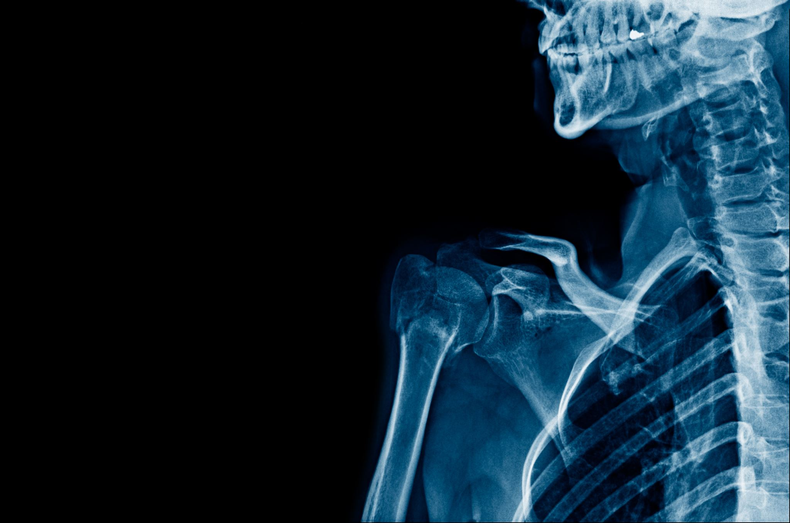
Bone Fracture Classification Using CNN
Ashitosh Dhungana
10/14/2024

Slide 2

Introduction
Why is fracture detection essential???
Manually detecting fractures can be prone to human error and time-consuming.
Build a machine learning model that classifies bone fractures from X-ray images.

Slide 3

Deep Learning and Neural Network
Part of Machine Learning that aids machine to predict data through neurons.
Proven to be effective:
Image Classification
Speech Recognition
Neural Network: Machine Learning Model designed to mimic human brain processing.
Consists of blocks of deep learning and neurons
Key Components: Neurons, Layers and Activate Functions

Slide 4
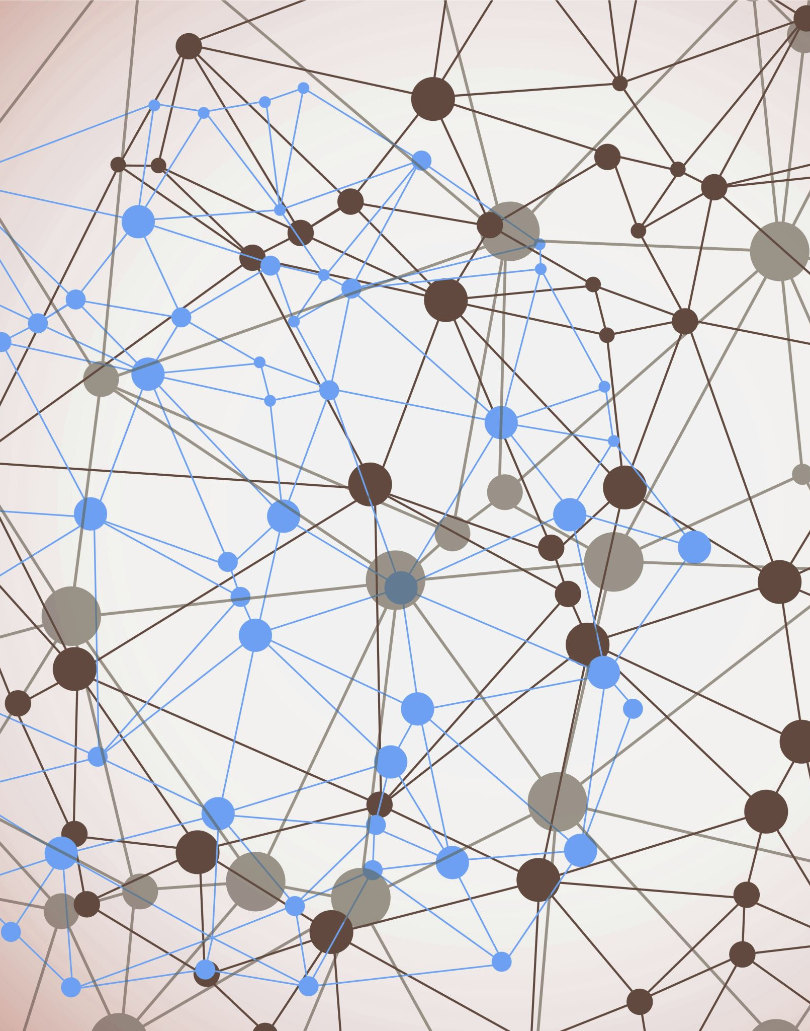
What are CNNs
Neural networks designed to process pixel data
Effective for image recognition tasks
Uses convolutional layers to extract features from images
Used in Image Classification
Identifying features like edges, textures, patterns from images
Useful for this project because, it can identify pattern in X-Ray images that classify them as fractured or not fractured.

Slide 5
CNN Further Explanation
Key Components:
Convolutional Layer: Core layer where the filter extract the feature(edges, lines, textures, other patterns)
Relu(Rectified Linear Unit): Assists the network to learn complex patterns by amplifying important features
Pooling Layer: Reduces Dimensionality of feature maps
Fully Connected Layer: This layer aggregates the process to make final classification
Output Layer: Uses Sigmoid activation function to produce a probability score to predict

Slide 6

Choosing of Data
Dataset Source: Kaggle
Name: Bone Fracture Multi Region X-Ray Data
Consists of 10,580 radiographic images of X-Ray
Training Data: 9246 Images
Validation Data: 828 Images
Test Data: 506 Images

Slide 7
Dataset Pre-Processing
Original Size of the Image: 224*224 pixels
Converted Size: 64*64 pixels , grayscale format
Labels Converted based on folder names: 0 for fractured and 1 for not fractured

Slide 8
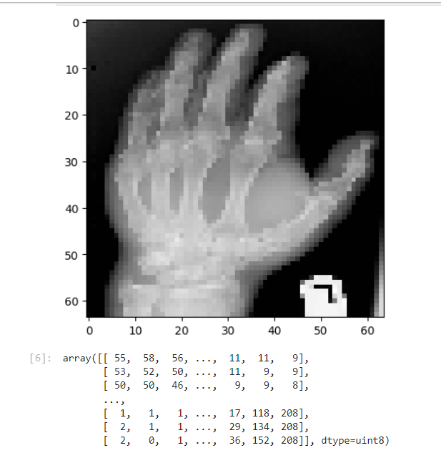
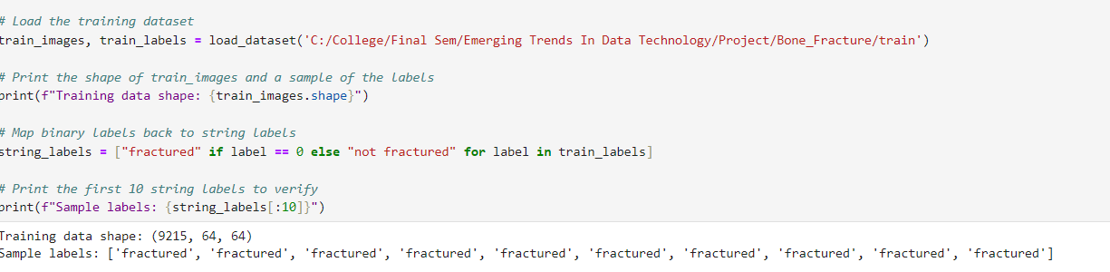
Roadmap
Image into NumPy array and get the labels
From files fractured and not-fractured

Slide 9
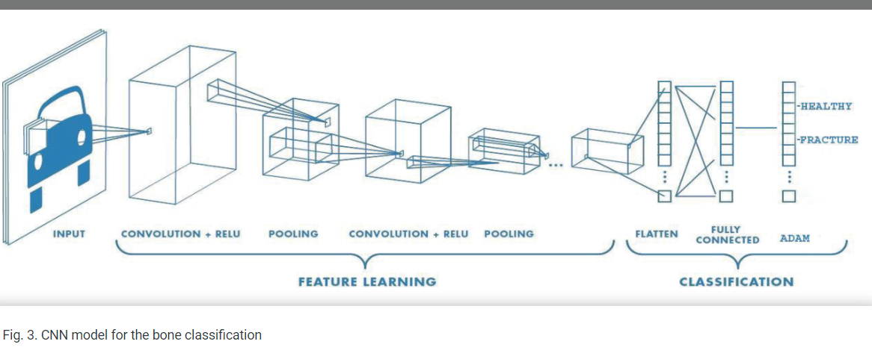
CNN Architecture overview

Slide 10
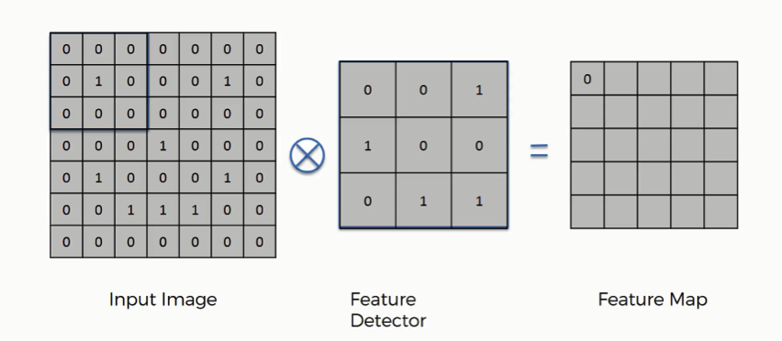
CNN Helps in classifying X-ray image as Fractured or not by feature extraction and mapping those feature to correct labels.
1.Image Input as Matrices: 64*64 pixel X-Ray Image
Represented as a 64x64 matrix, where each entry in the matrix corresponds to a pixel's intensity.
2.Convolutional Layer: Apply filter in small matrices to extract features.
Each filter is a 3*3 matrix: For example:
[ [0, 1, 0],
[1, -4, 1],
[0, 1, 0]]
When applied to a region of the image matrix (e.g., a 3x3 section of the X-ray)
Output = Feature Map

Slide 11
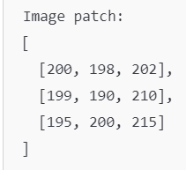
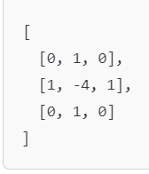
Feature Map Cont.
The Feature Map Value would be :Feature map value = (200*0 + 198*1 + 202*0) + (199*1 + 190*(-4) + 210*1) + (195*0 + 200*1 + 215*0) = 30
Same process is repeated the entire image to develop a feature map.

Slide 12

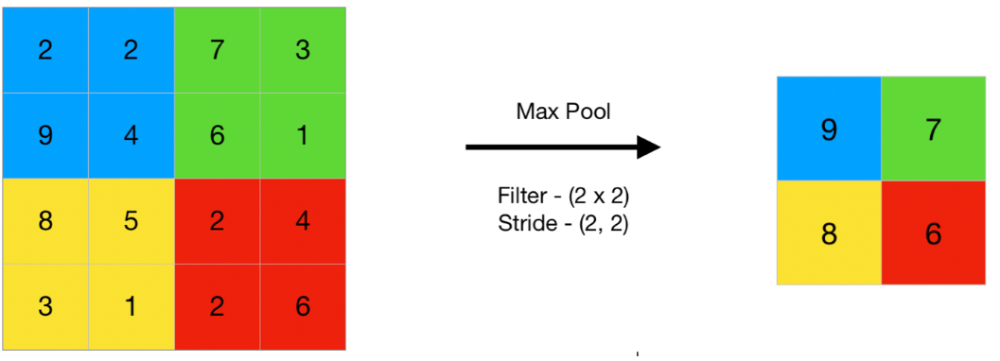
Pooling layer = Down Sampling
selects the maximum element from the region of the feature map covered by the filter.
The output would be Feature maps that holds most prominent features of the Previous feature maps

Slide 13
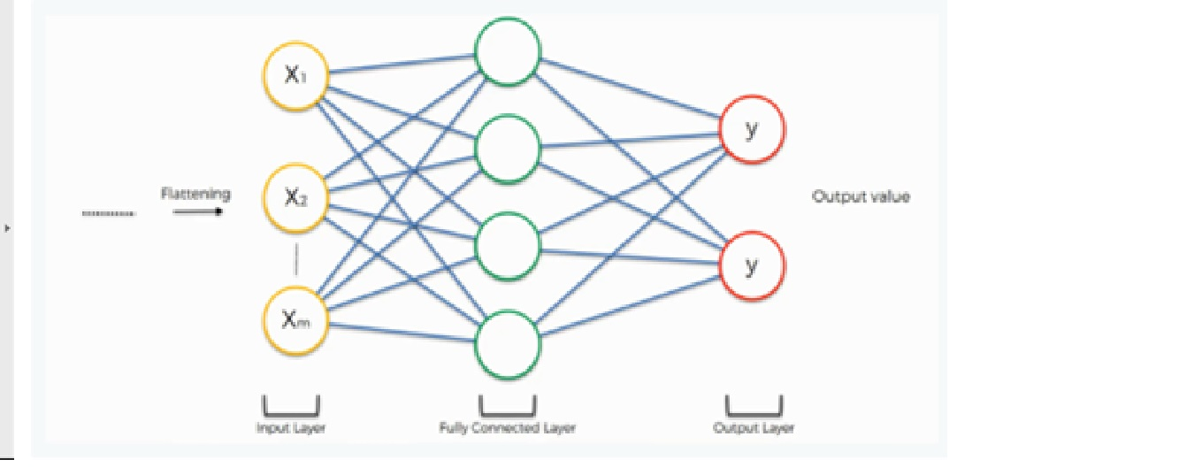
Fully Connected Layer
Post multiple convolution and pooling : 1D Vector
This layer combines the features and makes the final decision.
Using activation function (such as sigmoid for binary classification).
Flattened Vector: [0.2, 0.8, 0.5, 0.7] * Fully Connected Layer[[0.1, 0.4, 0.3, 0.2]]
This results in (0.2*0.1) + (0.8*0.4) + (0.5*0.3) + (0.7*0.2) = 0.51

Slide 14
Output Layer
Value is passed to a sigmoid activation function to generate a probability score
0 or 1
If value is closer to 0: Fractured
If closer to 1: Not fractured
The final layer consists of 1 neuron : 0 or 1 that classifies the bone as Fractured or Not-Fractured

Slide 15
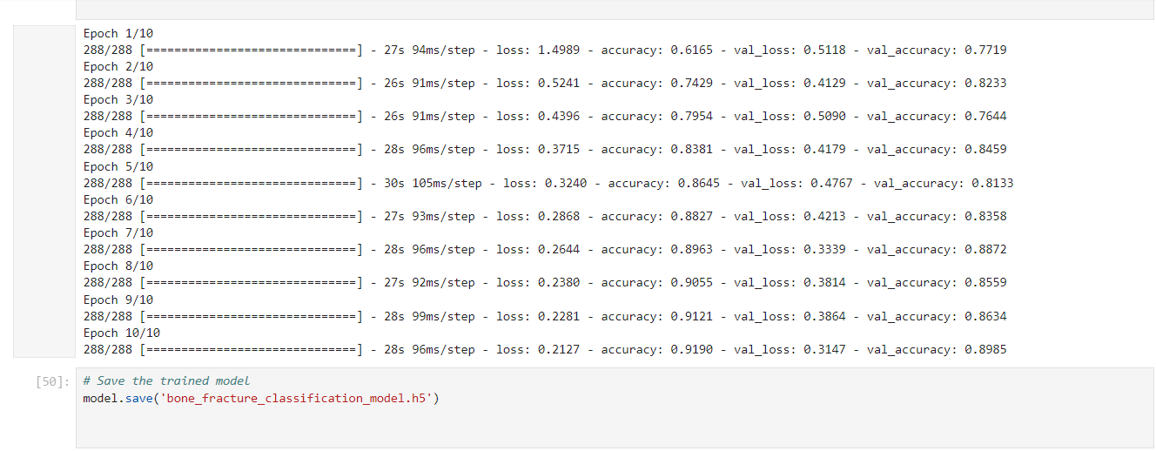
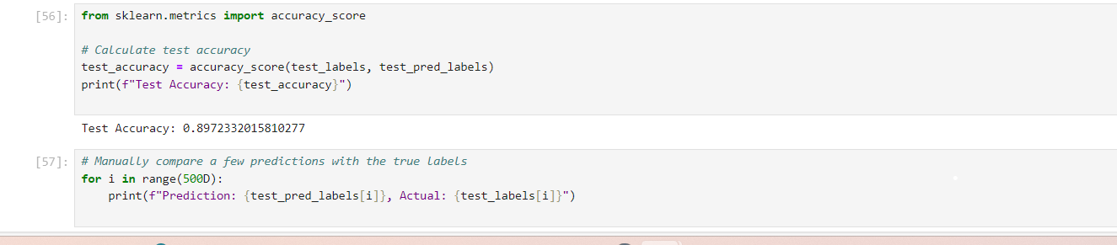
Training Process: Train the model through 10 epochs

Slide 16
Model Evaluation
Two primary evaluation metrics
Accuracy and Confusion Matrix
The model achieved an accuracy of 89% on the test set, meaning it correctly classified 89 out of every 100 X-ray images.

Slide 17
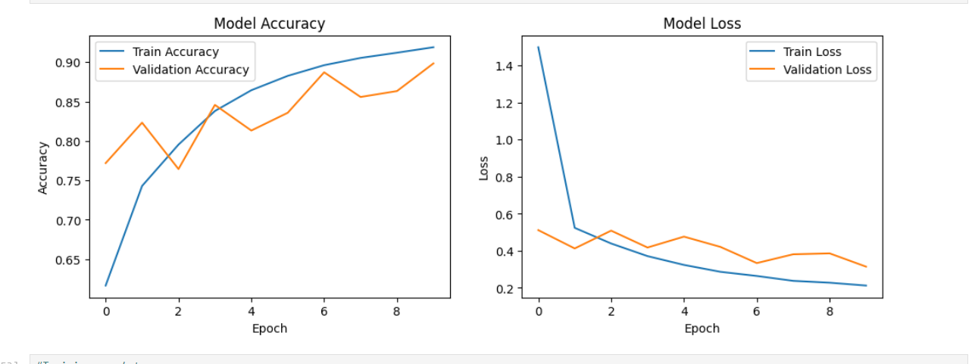
Accuracy Curves
The graphs suggest that minor gaps between training and validation curves suggest that model is performing well and there is less chance of overfitting.

Slide 18
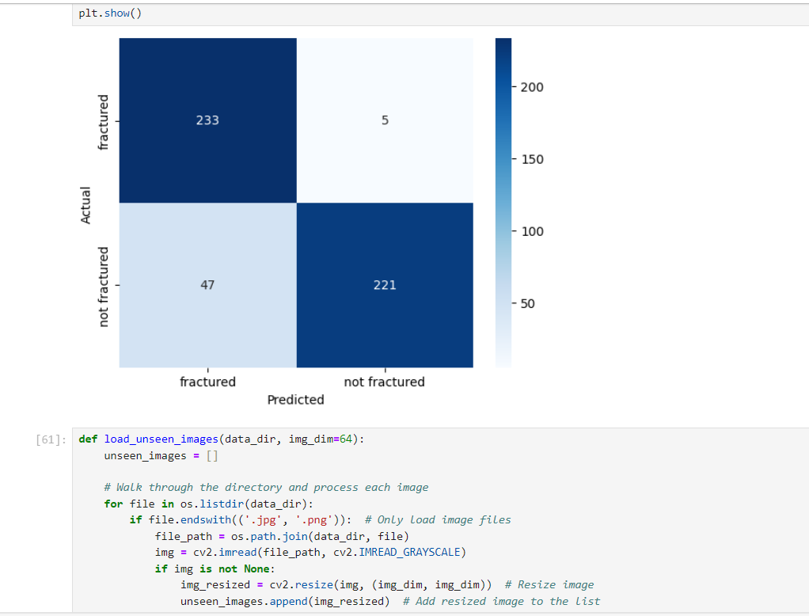
Results
The confusion matrix depicts that the model has a high recall rate, meaning it can be considered at identifying actual fractures.

Slide 19
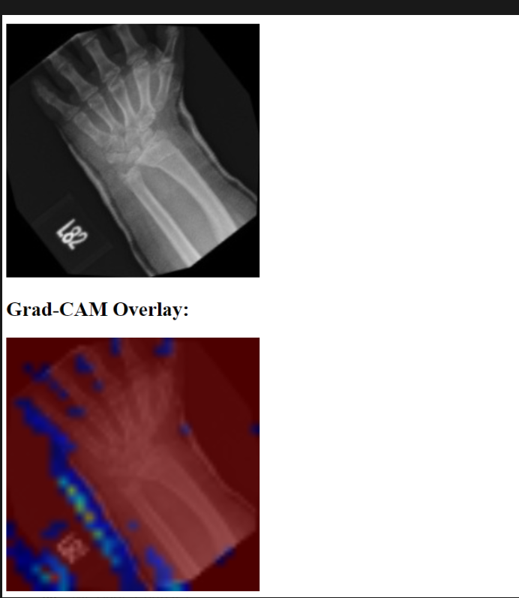
Challenges
Locating the exact point of fracture.
Lack of concise and clear result because it used heatmap.(Gradient weighted-class activation map.)
The Grad-CAM technique utilizes the gradients of the classification score with respect to the final convolutional feature map, to identify the parts of an input image that most impact the classification score.
The places where this gradient is large are exactly the places where the final score depends most on the data

Slide 20
Future Works
Extensive Research on CNN architecture and its application.
AlexNet
VGGNet ResNet
Potential research on developing a module that will locate the exact fracture point as well.

Slide 21
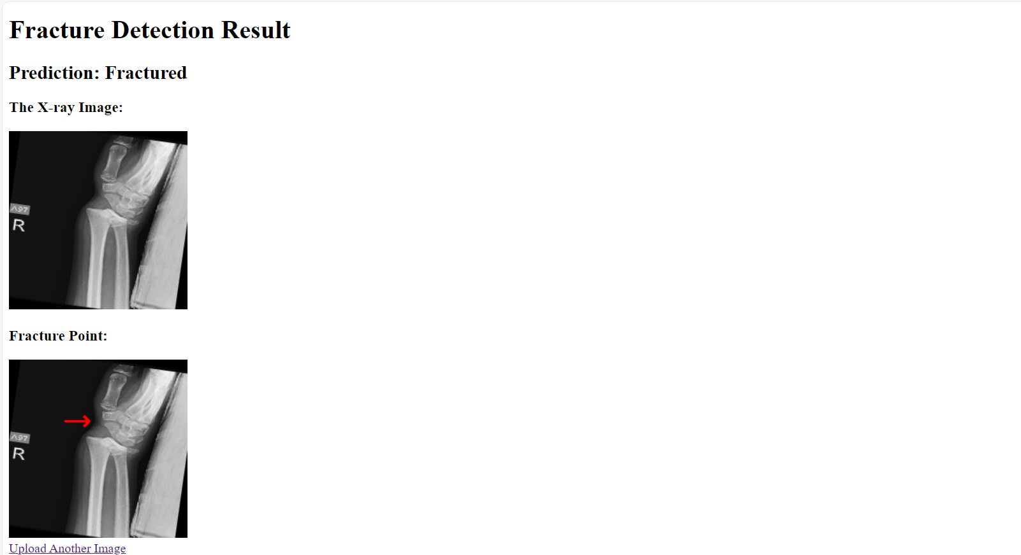
Current Interface

Slide 22
Conclusion
The development of CNN based model for Bone Fracture Classification addresses a critical need in medical diagnostics.
The implementation of this system in healthcare settings can assist radiologists by providing a second opinion and reducing diagnostic time.
Therefore, this research shows how AI can revolutionize medical imaging by using deep learning.

